Slide 1

Mini project-I
ONLINE QUIZ GENERATOR
DEPARTMENT OF COMPUTER SCIENCE ENGINEERING AND APPLICATIONS
Institute Of Engineering and Technology

Slide 2
Submitted By:
Pratibha Dixit
(181500498)
And
Megha Kansal
(181500382)
Supervised By:
Mr. Anand Kumar Gupta
Asst. Professor
Department of Computer Science & Applications
And
Ms. Ruchi Gupta
Asst. Professor
Department of Computer Science & Applications

Slide 3
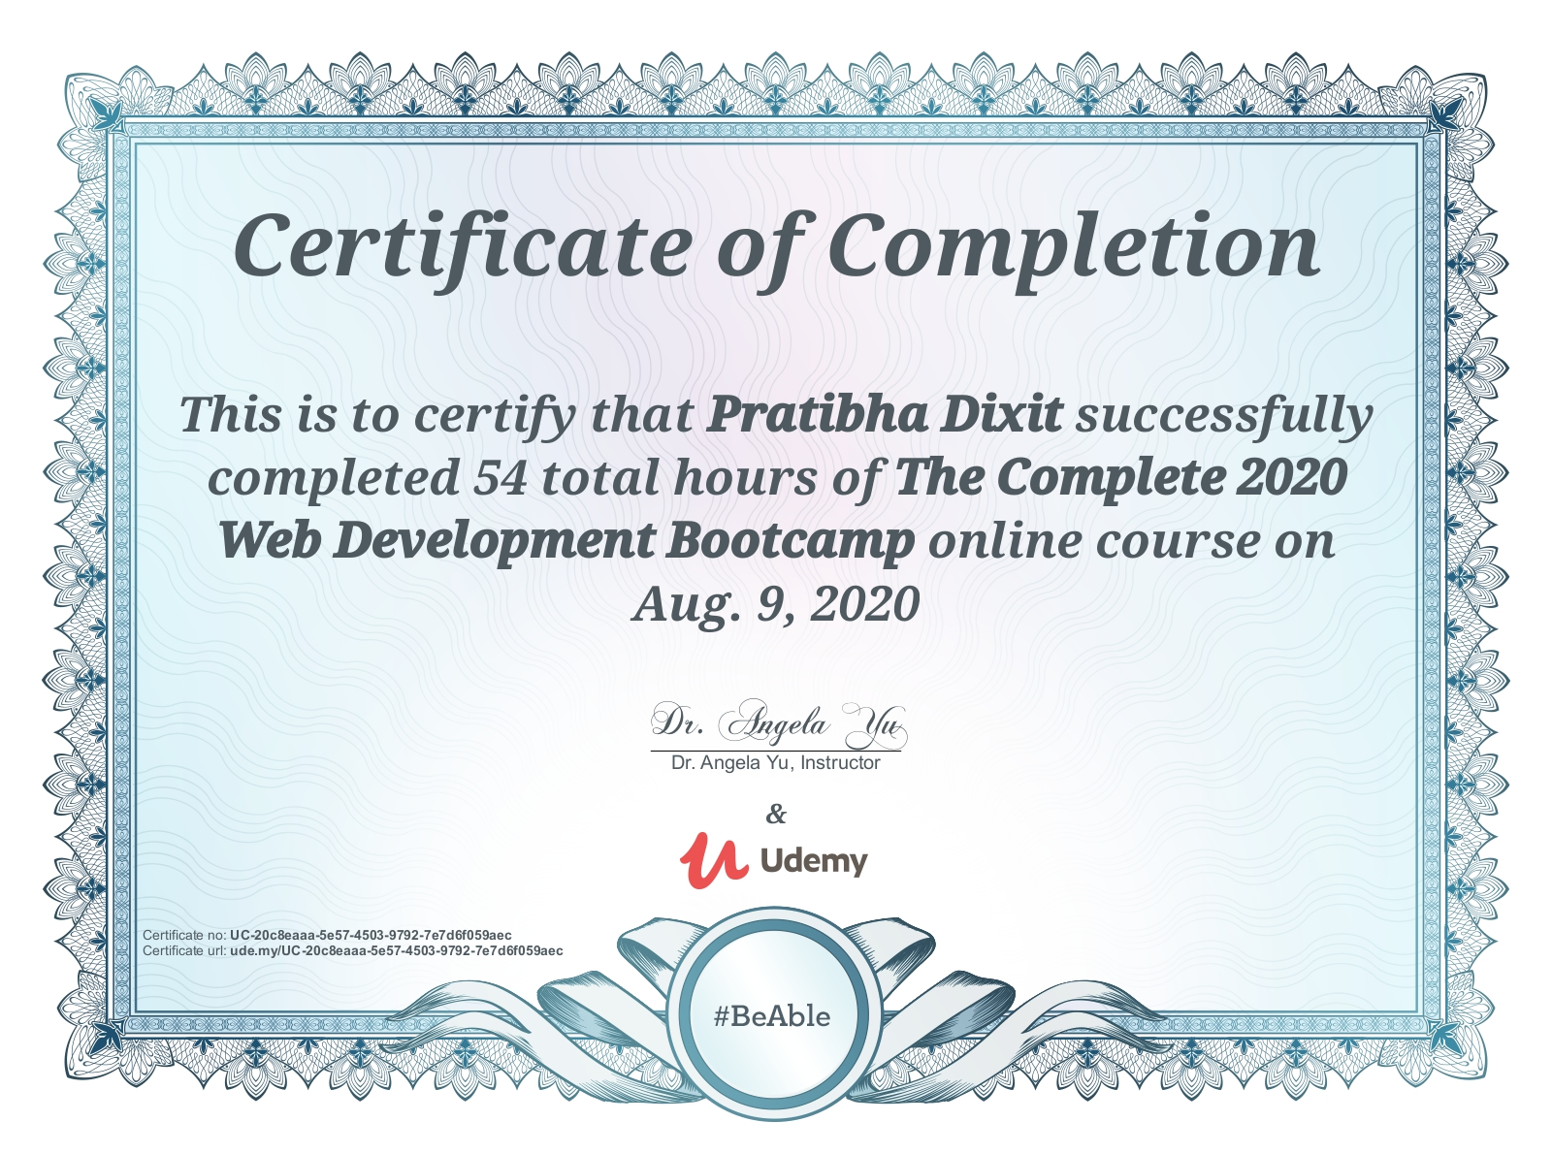
CERTIFICATES
1. Certificate of the Course attended by Pratibha Dixit:

Slide 4
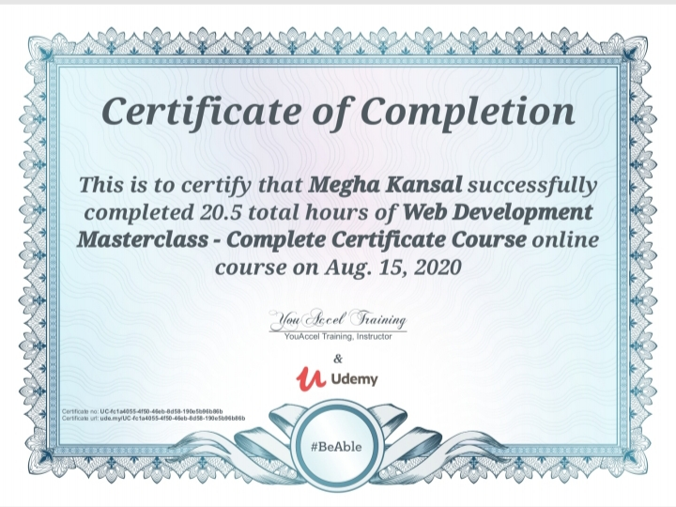
2. Certificate of the Course attended by Megha Kansal:

Slide 5
About the Course/Training Attended By ‘pratibha dixt’:
No programming experience needed.
This course consists of 53.5 hours on-demand videos.
In this course we cover the following tools and technologies:
Front-End Web Development:
HTML 5
CSS 3
Bootstrap 4
Javascript ES6
DOM Manipulation
jQuery
Bash Command Line
Git, GitHub Version Control

Slide 6
Backend Web Development:
Node.js
NPM
Express.js
EJS
REST
APIs
Databases
SQL
MongoDB
Mongoose
Authentication
Firebase
React.js
React Hooks
Web Design
Deployment with GitHub Pages, Heroku and MongoDB Atlas

Slide 7
About the Course/Training Attended By ‘Megha Kansal’:
No programming experience needed.
This course consists of 20.5 hours on demand videos.
In this course we cover the following tools and technologies:
How The Internet Works
The Web Development Process
Planning A Website
Web Hosting And System Requirements
Domain Names
Testing Environment
Production Environment
FTP Setup

Slide 8
HTML Development
CSS Development
Document Object Model (DOM)
JavaScript Development
jQuery Library
Bootstrap Framework
PHP Development
MySQL Database Integration
XML | AJAX
Google Apps For Work
SSL Certificates – How To Secure Your Server

Slide 9
PROJECT
Online quiz generator

Slide 10
Introduction:
The “Online Quiz Generator” is a web application for to take online test in an efficient manner and no time wasting for checking the paper.
Every admin has a user id and password to create and check marks of each quiz.
Every user has user id and password to attend a quiz.

Slide 11
Synopsis-
The main task of “Online Quiz Generator” is to efficiently evaluate a candidate thoroughly through a fully automated system that not only saves a lot of time but also gives fast results.
No restriction that examiner has to be present when the candidate takes test.
This web application can be used anywhere and at any time as it is a web based application (user location doesn’t matter).

Slide 12
Aim of this project
With the effective use, any Institute can use the “Online Quiz Generator” for conducting quick examinations and getting better results in less time.
Apache Server Pages, MYSQL database used to develop this “Online Quiz Generator” application where all admins and students can login through the secured web page by their account login id and password.
We have developed a Web-based online test/quiz system which can create quizzes competitively and collaboratively for students for the purpose of reducing the load required for a teacher and promoting interaction among teachers and students.

Slide 13
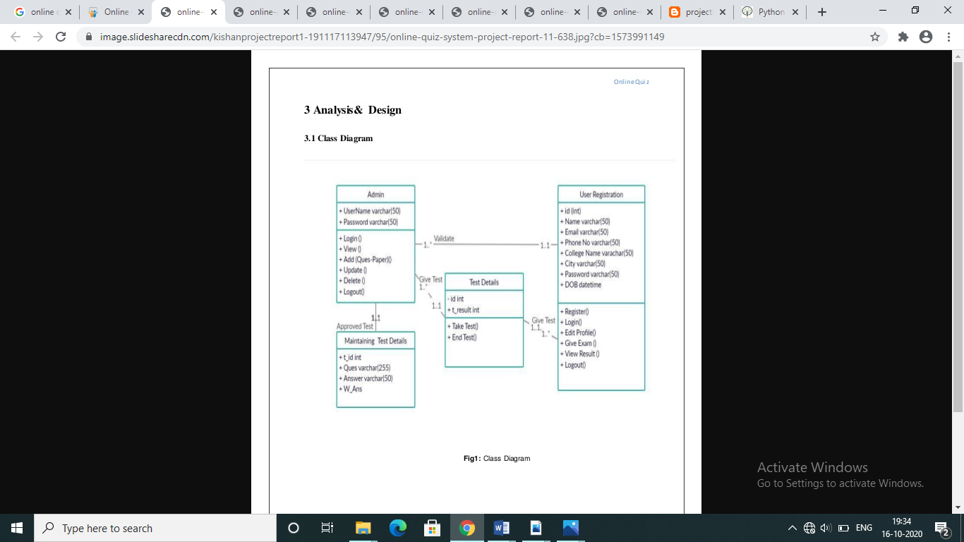
Class Diagram:

Slide 14
ERD (Entity Relationship Diagram):

Slide 15
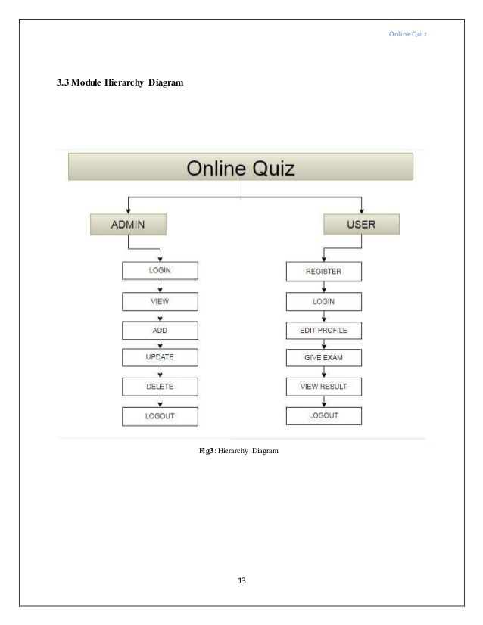
Model Hierarchy Diagram:

Slide 16
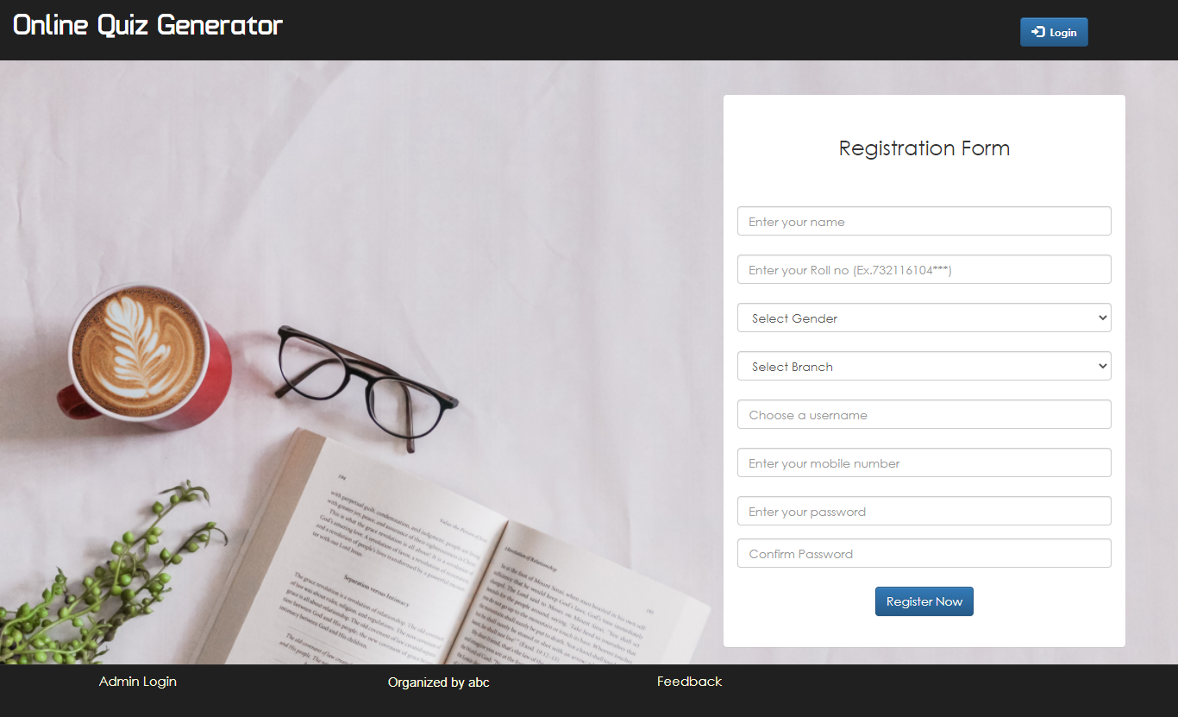
Screenshots
Index page:

Slide 17
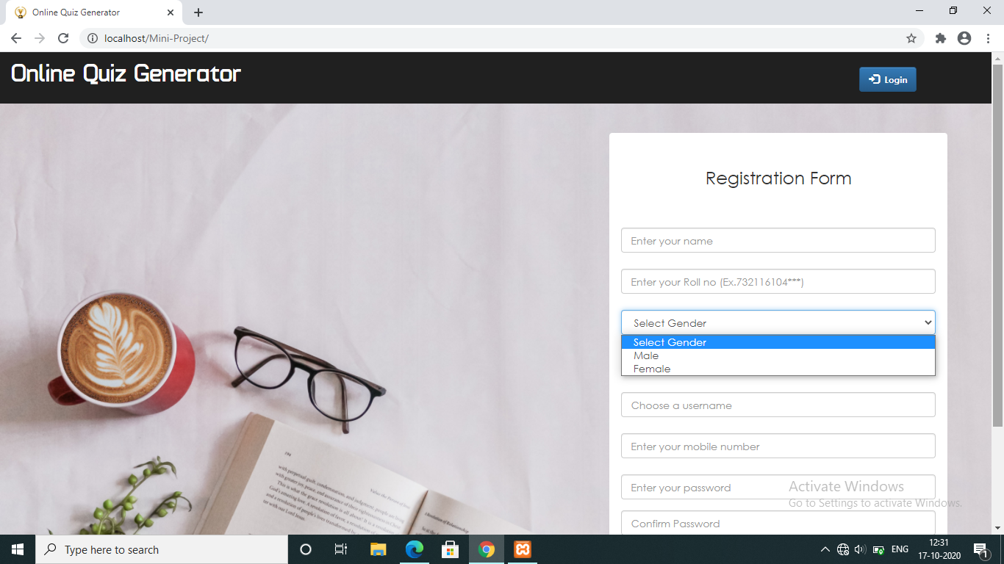

Slide 18
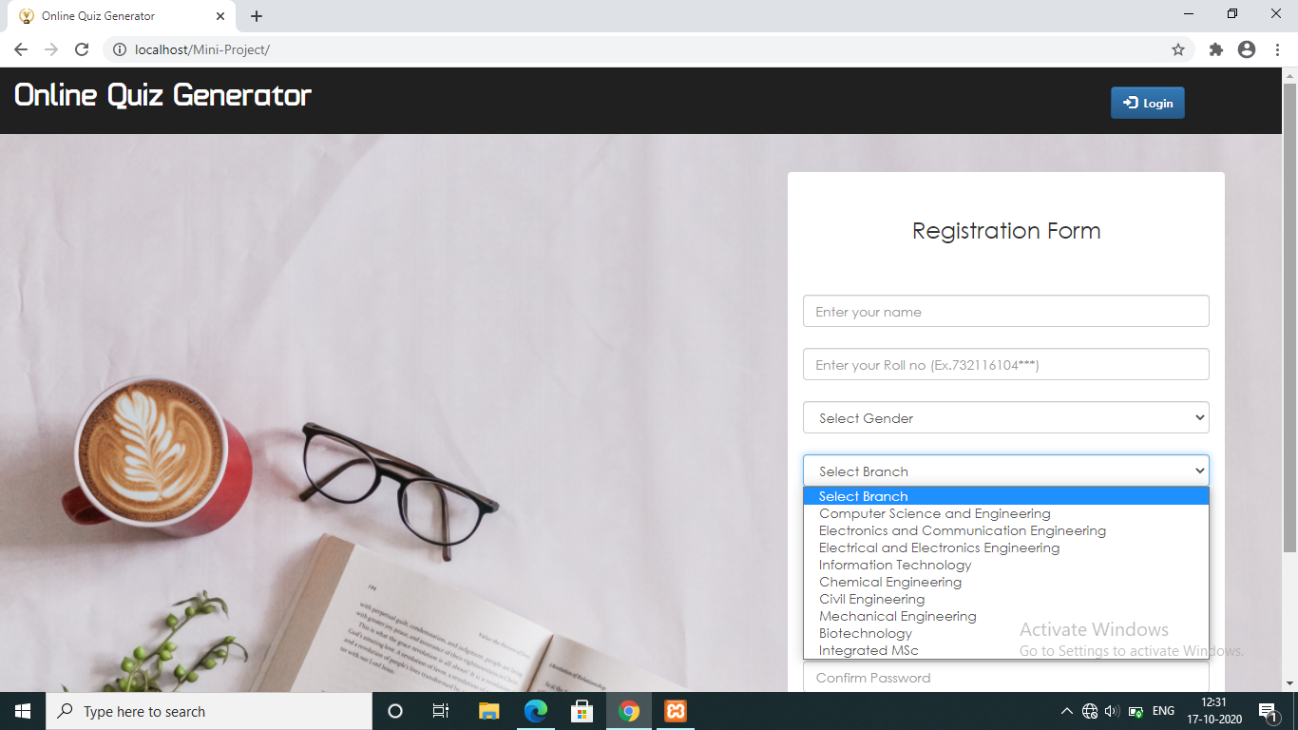

Slide 19


Slide 20
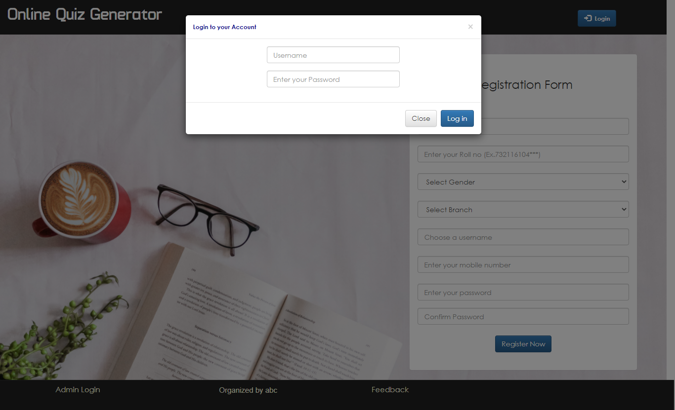
Login Screens:

Slide 21
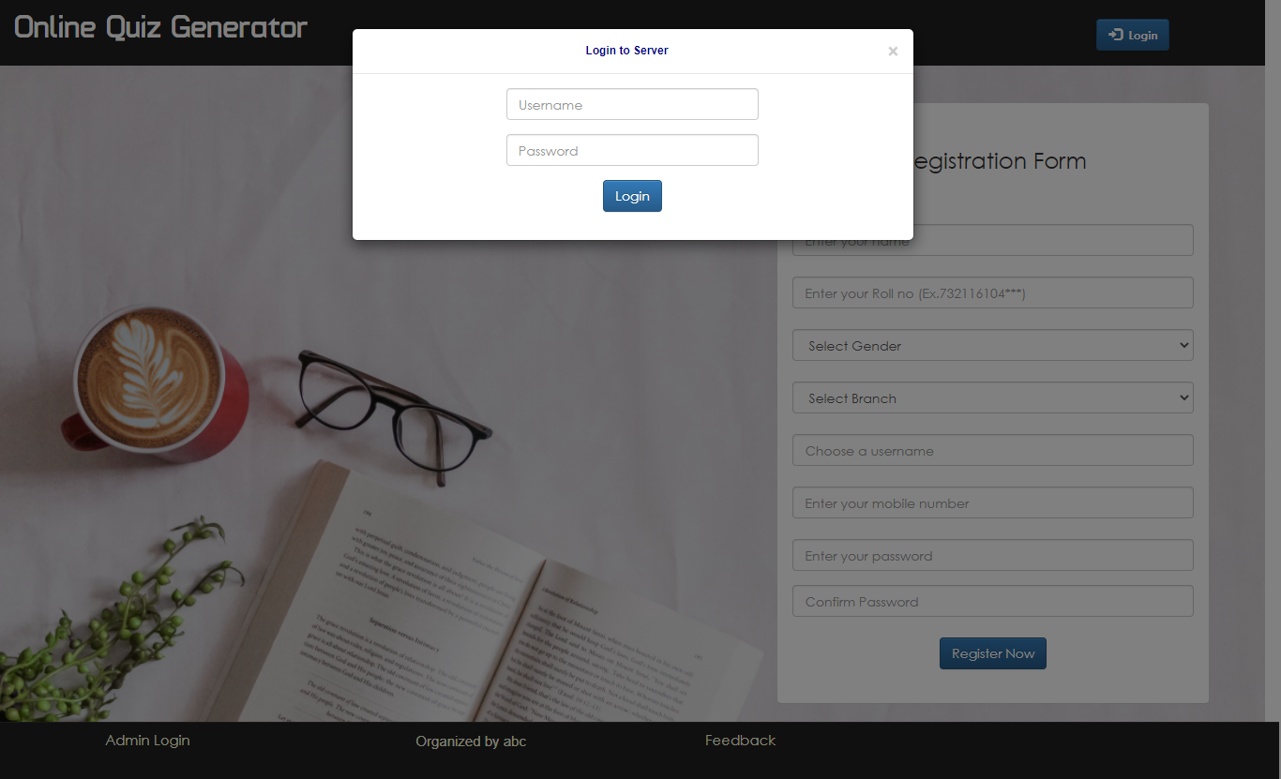

Slide 22
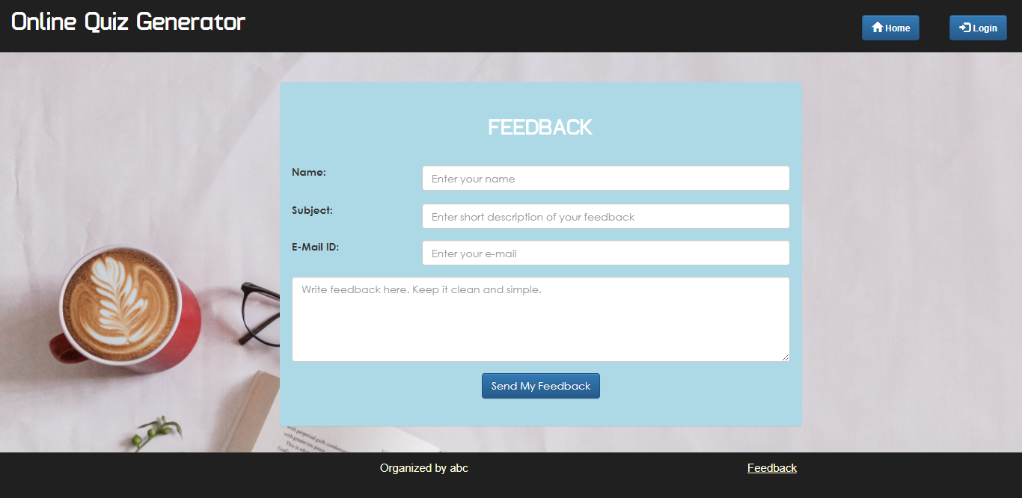
Feedback Screen:

Slide 23

Admin Pages:

Slide 24
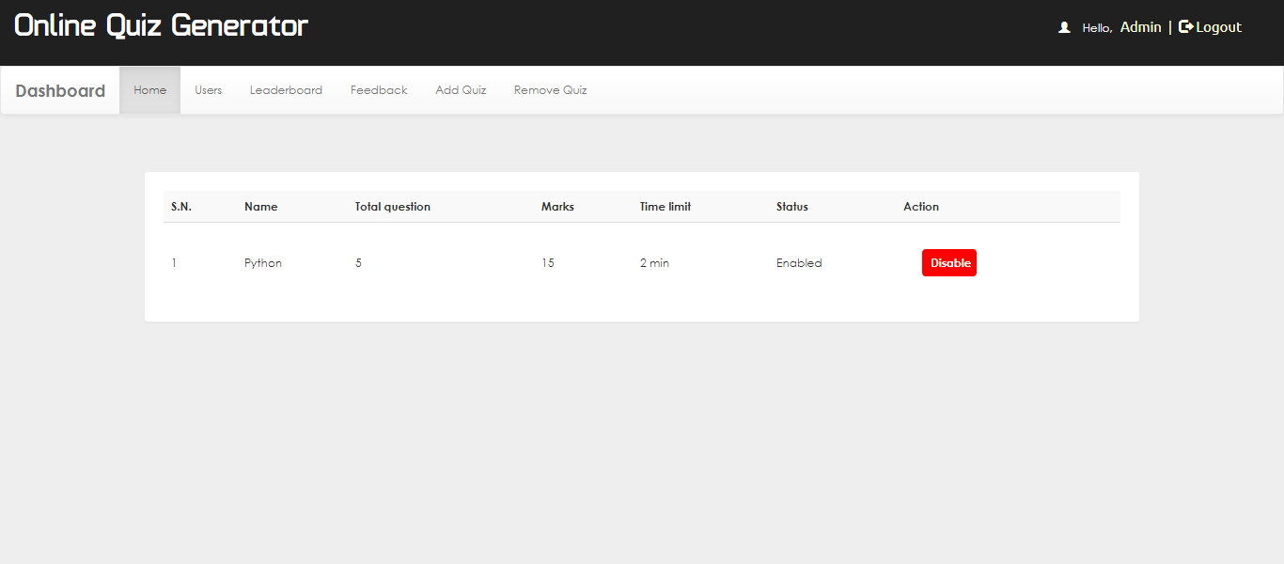

Slide 25
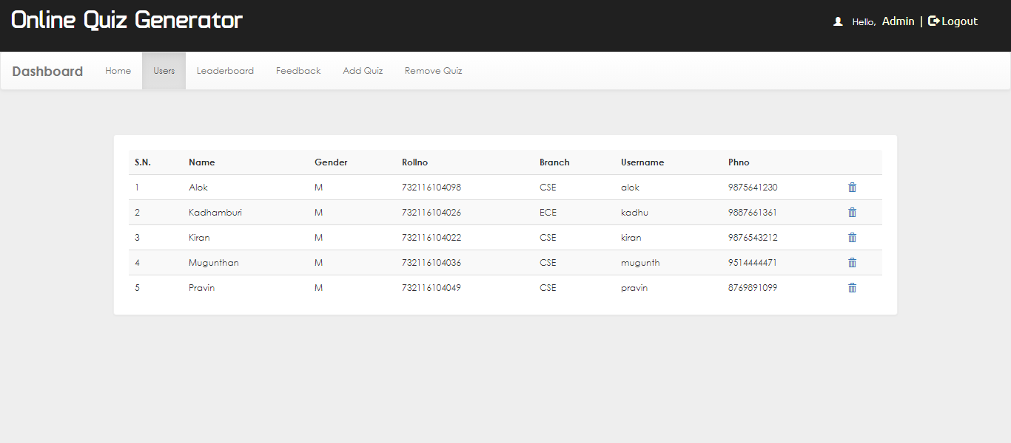

Slide 26
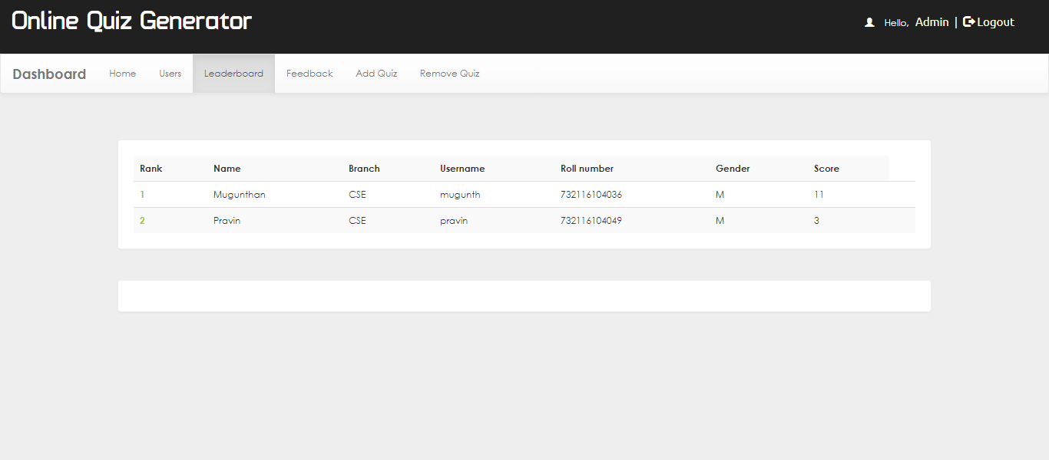

Slide 27
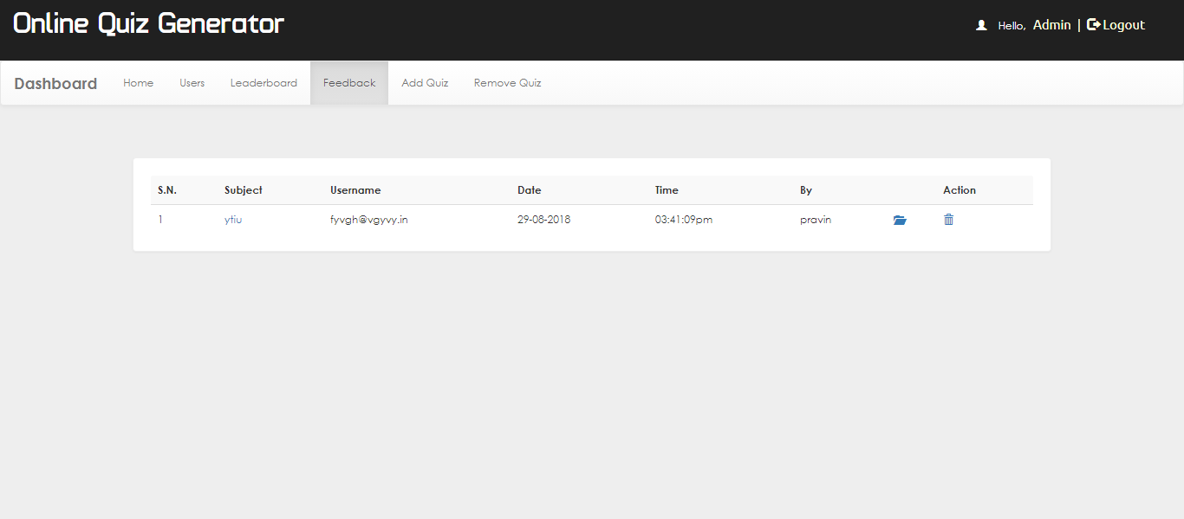

Slide 28
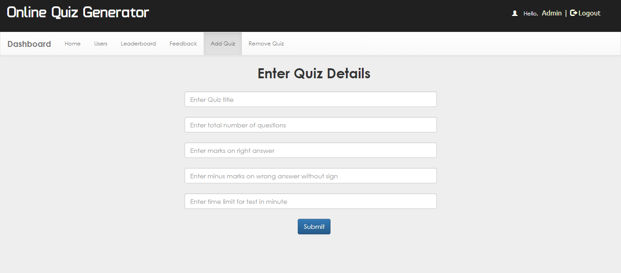

Slide 29
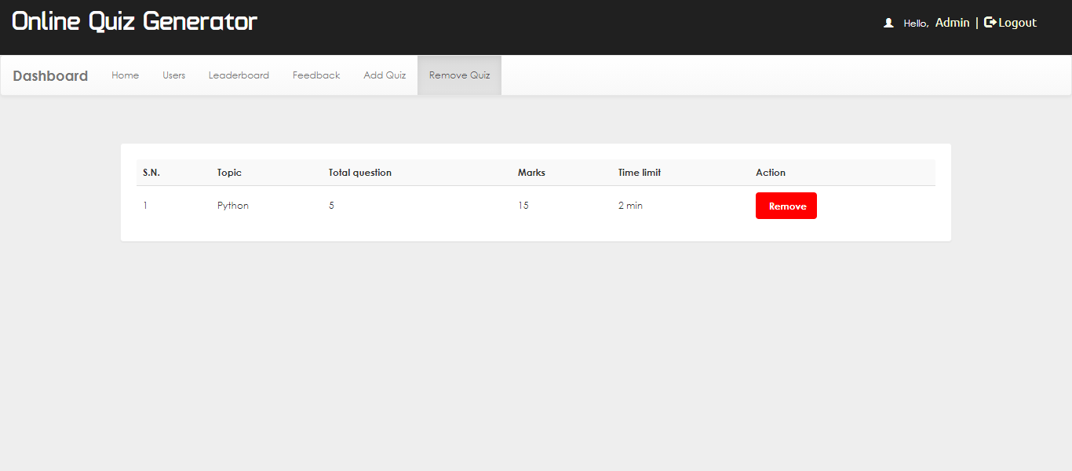

Slide 30

Student Pages:

Slide 31
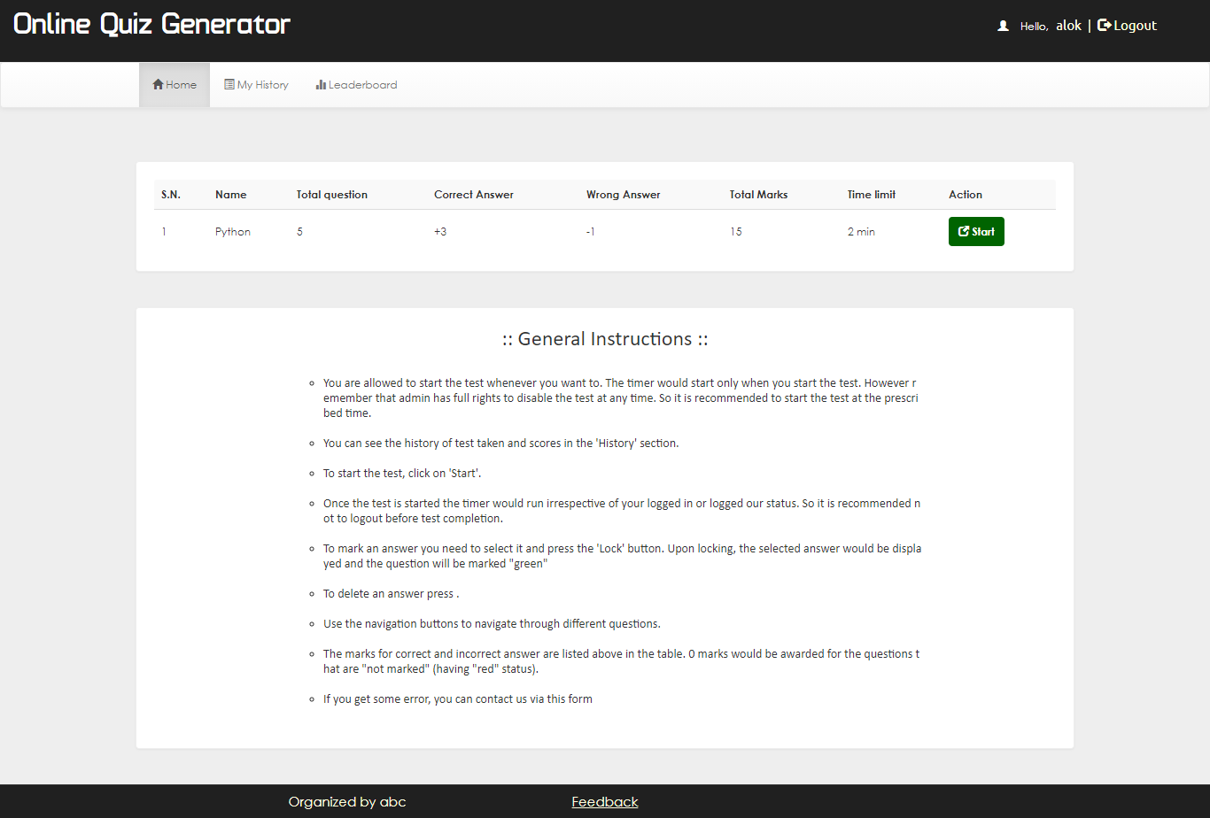

Slide 32
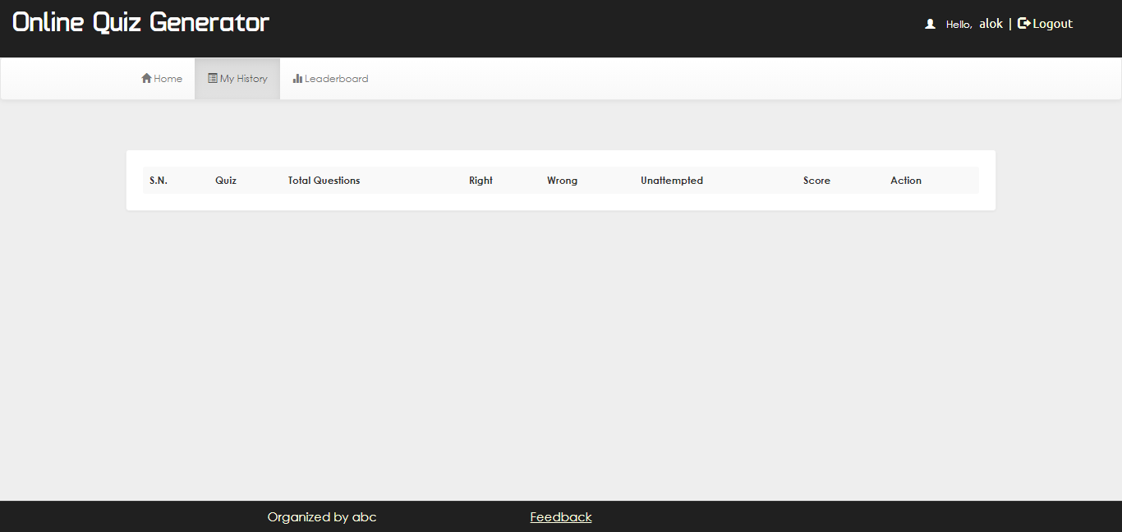

Slide 33
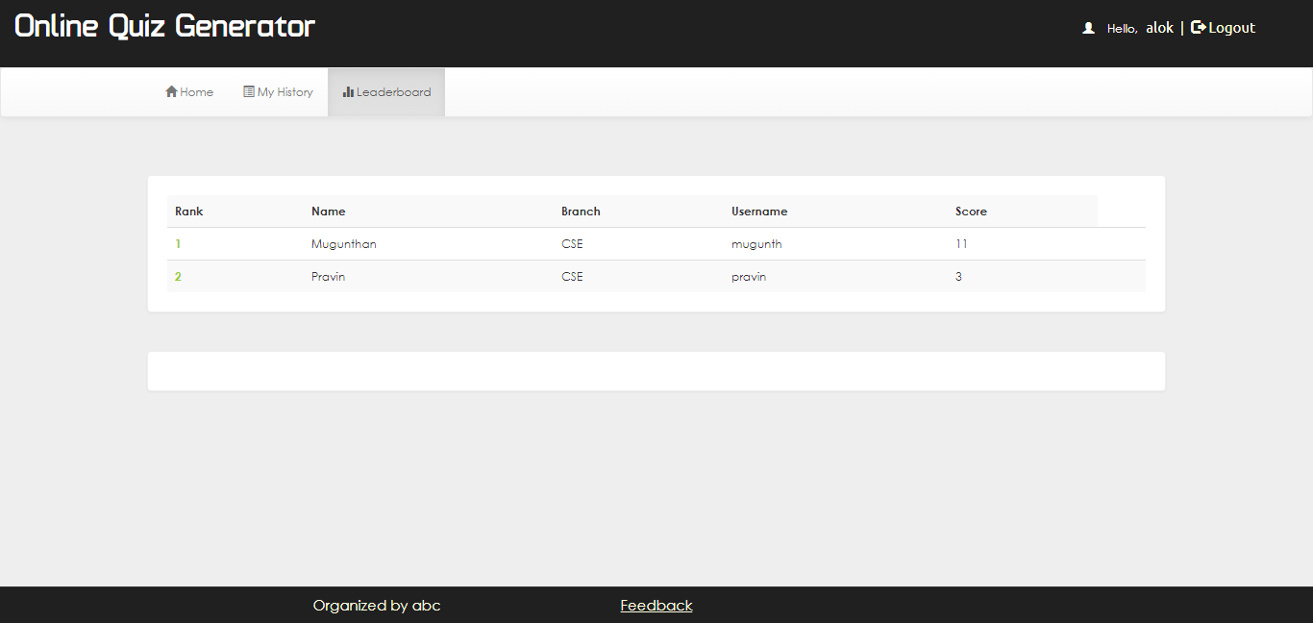

Slide 34
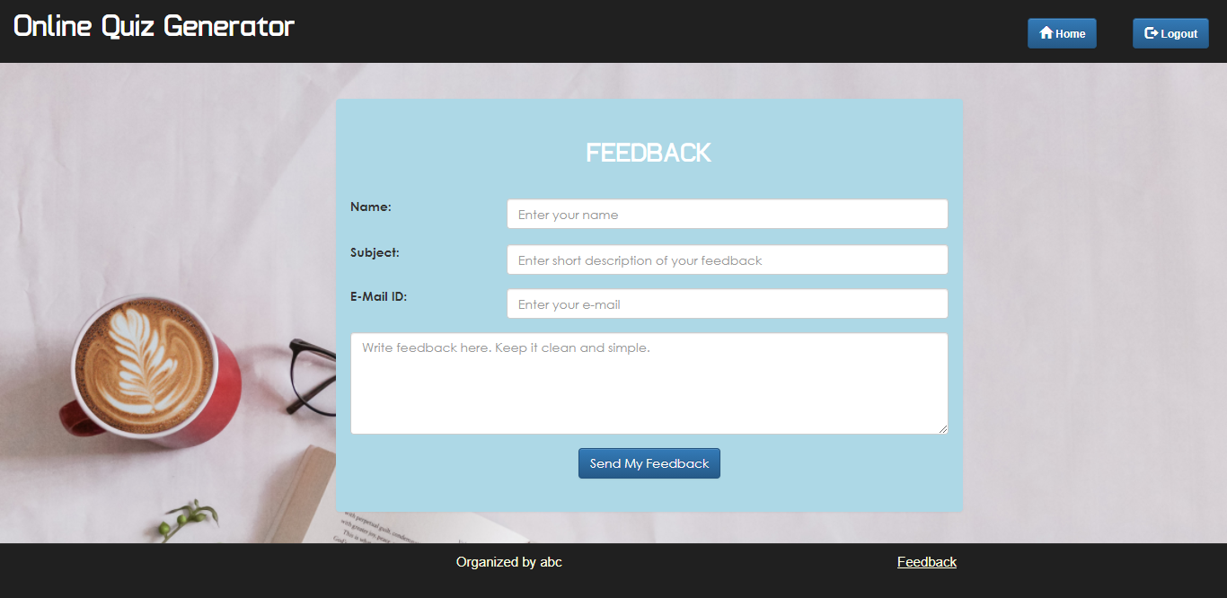

Slide 35
Benefits of Online Quiz Generator
Online Quiz Generator is fast, secure, convenient and free.
Quick, simple, authenticated access to accounts via the web application.
Simply scalable to grow with changing system requirement.
Global enterprise wide access to information.
Improved data security, restricting unauthorized access.
Minimum storage space.

Slide 36
Conclusion
This project is developed to nurture the needs of a user on an online environment by embedding all the tasks of assigning and completing quizzes on a single platform.
Future version of this software will still be much enhanced, than the current version 1.0, thus the “Online Quiz Generator”, is developed and executed successfully.

Slide 37
Code Link for
Bank Management System
Link-1 to Pratibha Dixit’s repository:
Link: https://github.com/pratibhadixit3990/Mini-Project
Link-2 to Megha Kansal’s repository:
Link: https://github.com/meghakansal12/MiniProject-Online_Quiz_Generator
Note:
Both repositories contain complete source code. Hence you can use any one to get full Source code of the project.

Slide 38
References/Bibliography for Projects
We referred to the following resources:
Course for Full-Stack Development on Udemy
1. Course Name: The Complete 2020 Web Development Bootcamp
Link:https://www.udemy.com/course/the-complete-web-development-bootcamp/
Attended By: Pratibha Dixit
2. Course Name: Web Development Masterclass- Complete Certificate Course
Link:https://www.udemy.com/course/web-development-masterclass-complete-certificate-course/
Attended By: Megha Kansal
Google Search

Slide 39
Our ongoing Full-Stack lectures and lab assignments
Website for Web-development: https://www.beta-labs.in/
YouTube videos

Slide 40
THANK YOU

